Slide 1
Paramoecium sp.{part 1}: Locomotory organs
Sudipta Debbarma
H.O.D. Zoology

Slide 2
Introduction
Paramoecium is a typical ciliate protozoa.
Ciliates are characterised by the presence of cilia as locomotor organelle, nuclear dimorphism & a unique type of sexual reproduction called conjugation.
The 2 types of nuclei are morphologically & physiologically distinct from one another- Macronucleus and Micronucleus

Slide 3
Habit & habitat
P.caudatum is commonly found in freshwater ponds, pools, ditches, streams, lakes and rivers.
It is specially found in abundance in stagnant ponds rich in decaying matter, inorganic infusions, and in sewage water.
It is a free living organism.

Slide 4
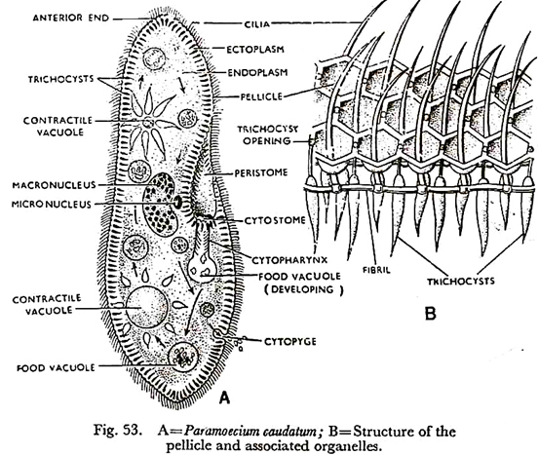

Slide 5
Structure
Size & shape:
P.caudatum is a microscopic organism & visible to the naked eyes as minute elongated body, it measures between 170 to 290 microns. It looks like a sole of a slipper. Hence the animal is known as Slipper animal cule.
The body is covered by a thin, double layered elastic pellicle made of gelatin.

Slide 6
Pellicle:
It has 2 membranes.
Outer membrane is continuos with cilia
Inner membrane is continuous with ectoplasm
Cilia:
Locomotory organ
Originated from a basal granule
2 central longitudinal fibrils & 9 peripheral fibrils

Slide 7
Ultrastructure of cilia
The cilia are bounded by an unit membrane of 90A⁰ thickness.
The bounded space contains a watery substance called matrix.
In the matrix there are 11 longitudinal fibrils. Out of the 11 fibrils 2 are in the centre and others at periphery.
Each outer fibril is 360A⁰ in diameter and composed of 2 sub fibrils of 180-250A⁰ diameter. These subfibrils are known as Subfibril A & B.

Slide 8
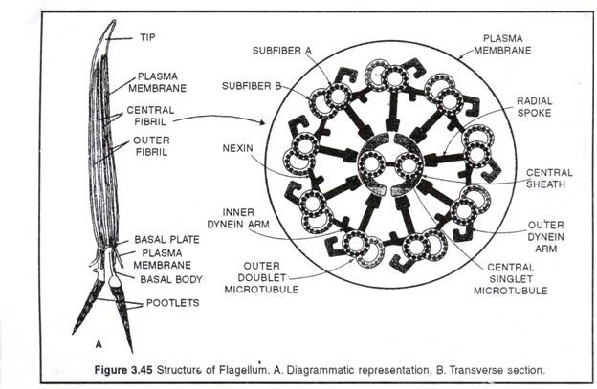

Slide 9
Subfibril A gives out 2 thick projections from its one side. The arms are directed in clockwise direction.
Both the sub fibrils have common wall.
The 2 central fibrils do not have any subfibrils.
Each central fibril has a diameter of about 250A⁰ .
Both the central fibrils remain separated by a space of 350A⁰ .
Gibbnos 1967 has reported that the sheath of the central fibrils gives out 9 radially oriented links to each subfibril A
The high resolution Electron microscopy has revealed that each fibril is composed of 10-12 filaments. Each filament is beaded.
These beads are considered as the basic subunit of the tubule structure of cilia.

Slide 10
Thank you

