Slide 1



Slide 2

Tripura on the Way of Global Economic Recession of Thirties
Dr. Nirmal Bhadra
Associate Professor
Swami Vivekananda Mahavidyalaya,
Mohanpur

Slide 3

Introduction
Present world of economy is well known with the fact of world economic crisis. It has been a common phenomenon for all the countries all around the world from the beginning of the 21st century as well as the last decade of this century. Consequently its impact was felt in the economy of this sub-continent. The gradually deteriorating world trade also had its influence on the trade of India. As a result the wholesale price Index was rapidly going down. This unwanted incident was also relevant with the then princely state of Hill Tripura, because the great economic recession from 1928 to 1934 widely influenced the economy of Tripura and British Bengal. In this study will focus on how the then princely state Tripura had been successful to overcome the situation within a short time before the Second World War.

Slide 4

The incident had occurred with the stock market crash in New York in 1929 then caused general crisis of confidence among all creditors and sent a shock wave of credit contraction around the world. As a result the wholesale price Index was rapidly going down.

Slide 5

Wholesale Price Index, India (1928-29 to 1933-34).
Year | Wholesale price index
1928-29 | 133.55
1929-30 | 112.50
1930-31 | 83.55
1931-32 | 82.89
1932-33 | 79.61
1933-34 | 78.28

Slide 6


Slide 7

Wholesale price index of India in agricultural and non-agricultural products (1928-1934)
Year | Agricultural Products | Non-Agricultural Products
1928 | 267 | 182
1929 | 252 | 182
1930 | 206 | 154
1931 | 142 | 120
1932 | 128 | 116
1933 | 125 | 113
1934 | 130 | 109

Slide 8


Slide 9

>Tirthankar Roy
>D.N.Tripathi
>Sabyasachi Bhattacharjee
>Amiya Bagchi
>Bipan Chandra
>S.K.Mukhopadhyay
Contributing scholars on the aspects of British India

Slide 10

Sources on Tripura
>S.C.Debbarman(1931)
>B.C.Datta
>Prof.Dipak Kumar Choudhury
>Government administrative reports(1929-1943)
>Gazetteers

Slide 11

Aspects of economic scenario
Three types of economy:-
1)Pastoral Economy.
2)Agrarian Economy.
3)Feudal Economy(Influenced by the Colonial Economy).

Slide 12

Jhum based pastoral economy
In the hills of Tripura during this time under discussion pastoral economic system was practiced by-and-large. Carpas(Local name of cotton) was the only cash crop grown by the Tribal people ; But during recession its price fell down drastically. Moreover , since the tribal people didn’t have the habit of saving money thy suffered heavily.

Slide 13

Agrarian economy
Agrarian economy was prevailing in the plains of Tripura .So the recession also affected the price of rice, jute and tea seriously.

Slide 14

Feudal Economy of the Tripura state
The financial condition of the princely state Tripura also became paralyzed. Hence, the revenue of the state fell down rapidly. The following table shows the trend of decline.

Slide 15

Year | Amount of Revenue (In Rs.) | Increase | Decrease
1928-29 | 19,46,421 | 69,285 | -
1929-30 | 18,78,321 | - | 68,100
1930-31 | 13,92,709 | - | 4,85,612
1931-32 | 12,37,252 | - | 1,55,457
1932-33 | 13,49,108 | 1,11,856 | -
1933-34 | 13,39,810 | - | 9,298

Slide 16


Slide 17

Majors taken by the state to combat the new situation
>Re-introduction of Jangalabadi bandyobasta
>Encouragement of Non-Tribe migration
>Re-Habilitation projects
>Loan and reward

Slide 18

Year | Amount of Revenue (In Rs.) | Increase | Decrease
1932-33 | 13,49,108 | 1,11,856 | -
1933-34 | 13,39,810 | - | 9,298
1934-35 | 15,79,609 | 2,39,799 | -
1935-36 | 16,96,043 | 1,16,434 | -
1936-37 | 18,75,373 | 1,79,330 | -
1937-38 | 18,43,805 | - | 31,568
1938-39 | 19,24,890 | 81,085 | -
1939-40 | 20,55,595 | 1,30,705 | -

Slide 19
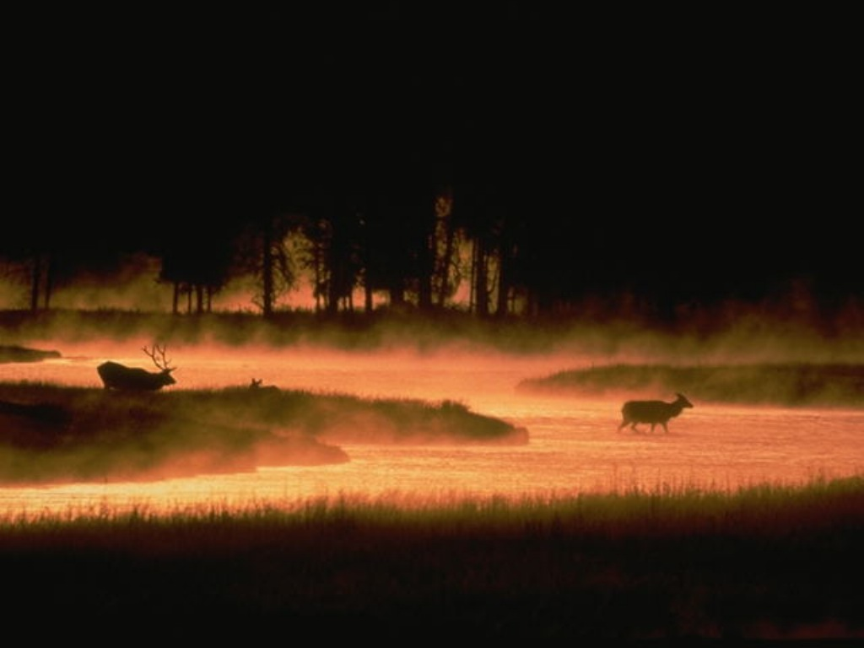
Conclusion
The majors taken by the state to improve the economy were encouraging . The economy became stable , now the King became able to provide financial assistance to the British in the Second World War. Besides, the king could offer relief to the victims of communal riot during1942,1946. Side by side migration of the non-tribe people was also accepted by the tribal people of the state during the pre-partition era.

Slide 20


Slide 21


Slide 22


Designed By:- Somarghya Bhadra

